Slide 1
ACTIVE AND PASSIVE VOICE

Slide 2

Voice
Voice is a grammatical category that applies to verbs.Voice in English expresses the relationship of the subject to the action.Voice has two values.
Active voice
Passive voice

Slide 3
Difference Between
Active voice Passive voice
The subject does the action
The Active voice is the “normal” voice the one that we use most of the time.In the active voice,the object receives the action of the verb.
The subject receives the action.
The Passive voice is less common.In the passive voice,the subject receives the action of the verb.
Always use 3rd form of verb.
Use different forms of verb.

Slide 4




Present
• Present
Future
Indefinate
Continuous
Perfect
Perfect
Continuous

Slide 5
INTRASITIVE VERBS(DO NOT CHANGE IN PASSIVE)
GO
LAUGH
SLEEP
DEPEND
LOOK
ARRIVE
FALL
DIE
SMILE
BECOME
CRY
WAKE
REMAIN
LIVE

Slide 6

SimplePresent
It is used to express an action in present time, habitual or usual actions or daily events or universal fact.
Active voice
Affirmative Sentence
Singular : S+1st form of verb+s or es+O
Plural: S+1st form of verb+O
Negative Sentence
Singular: S+helping verb(does)+not+1st form of verb+O
Plural: S+helping verb(do)+not+1st form of
verb+O
Interrogative Sentence
Singular :helping verb(does)++S+1st form of verb+O?
Plural: Helping verb(Do)+S+1st form of verb+O?
Passive voice
Affirmative Sentence
Singular :S+helping verb(is or am)+V 3rd +by+O Plural: S+helping verb(are)+V 3rd+by+O Negative Sentence
Singular: S+helping verb(is or am)+not+V 3rd
+by+O
Plural: S+helping verb(are)+V 3rd+by+O
Interrogative Sentence
Singular: S+helping verb(is or am)+3rd +by+O? Plural:Helping verb(Are)++S+V 3rd+by+O?

Slide 7

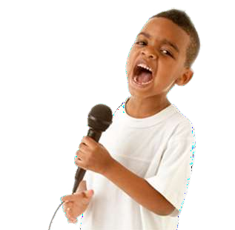
Simple Present
Passive voice
Affirmative Sentence
A song is sung by him.
Negative Sentence
A song is not sung by him.
Interrogative Sentence
Is a song sung by him?
Active voice
Affirmative Sentence
He sings a song.
Negative Sentence
He does not sing a song.
Interrogative Sentence
Does he sing a song?

Slide 8
Change into passive
1. He opens the door. -
The door is opened by him.
2. We set the table. -
The table is set by us.
3. She pays a lot of money. -
A lot of money is paid by her.
4. I draw a picture. -
A picture is drawn by me
5. They wear blue shoes. -
Blue shoes are worn by them.

Slide 9
6. They don't help you. -
You are not helped by them.
7. He doesn't open the book. -
The book is not opened by him.
8. You do not write the letter. -
The letter is not written by you.
9. Does your mum pick you up? -
Are you picked up by your mum?
10. Does the police officer catch the thief? –
Is the thief caught by the police officer?

Slide 10

Present Continuous Rules
In Present Continuous,the action is on-going /still going on and hence continous.
Active voice
Affirmative Sentence
Singular : S+helping verb(is or am)+V 1st +ing +O
Plural: S+helping verb(are)+V 1st +ing +O
Negative Sencent
Singular: S+helping verb(is or am )+not+V 1st
+ing+O
Plural: S+helping verb(are)+not+1st form of
verb+O
Interrogative Sentence
Singular :helping verb(is or am )+S+1st form of verb+O?
Plural: Helping verb(are)+S+1st form of
verb+ing+O?
Passive voice
Affirmative Sentence
Singular :S+helping verb(is or am+being)+V 3rd +by+O Plural: S+helping verb(are+being)+V 3rd+by+O
Negative Sencent
Singular: S+helping verb(is or am+not+being)+not+V 3rd
+by+O
Plural: S+helping verb(are+not+being)+V 3rd+by+O
Interrogative Sentence
Singular: S+helping verb(is or am+being)+3rd +by+O?
Plural:Helping verb(Are)+S+being+V 3rd+by+O?

Slide 11

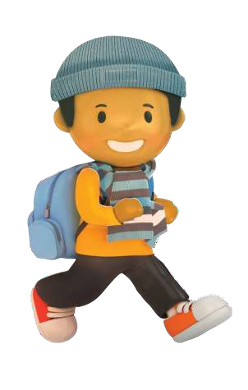

Present Continuous
Active voice
Affirmative Sentence
Jay is reading a book now.
Negative Sentence
Jay is not reading a book now.
Interrogative Sentence
Is Jay reading a book ?
Passive voice
Affirmative Sentence
A book is being read by Jay now.
Negative Sentence
A book is not being read by Jay.
Interrogative Sentence
Is a book being read by Jay?

Slide 12
Change into passive voice
Ruchita is drinking a cup of tea. -
A cup of tea is being drunk by Sheila.
My father is washing the car. -
The car is being washed by my father.
Farmer Joe is milking the cows. -
The cows are being milked by farmer Joe.
She is taking a picture of him. -
A picture of him is being taken by her.
I am writing a poem. -
A poem is being written by me.

Slide 13
We are not playing football. -
Football is not being played by us.
He is not wearing a tie. -
A tie is not being worn by him.
Is she preparing tea? -
Is tea being prepared by her?
Are they talking about the meeting?
Is the meeting being talked about by them?
Is she watering the flowers? –
Are the flowers being watered by her?

Slide 14

Simple Past Rules
Active voice
Affirmative Sentence
Singular : S+ 2nd form of verb+O Plural: S+2nd form of verb+O
EX. 1 They told him yesterday.
Negative Sentence
Singular: S+helping verb(did)+not+1st formverb+O
Plural: S+helping verb(did)+not+1st form verb+O
EX.1 They did not tell him yesterday.
Interrogative Sentence
Singular :helping verb(did)++S+1st form of verb+O? Plural: Helping verb(Did)+S+1st form of verb+O?
Did they tell him yesterday?
Passive voice
Affirmative Sentence
Singular :S+helping verb(Was)+V 3rd +by+O Plural: S+helping verb(Were)+V 3rd+by+O
EX.1 He was told by them yesterday.
Negative Sentence
Singular: S+helping verb(was)+not++V 3rd+by+O
Plural: S+helping verb(were)+not+V 3rd+by+O
EX.1 He was not told by them yesterday.
Interrogative Sentence
Singular: S+helping verb(was)+3rd +by+O? Plural:Helping verb(were)++S+V 3rd+by+O?
EX. Was he told by them yesterday?

Slide 15


Simple past
Active voice
Affirmative Sentence
She Wrote a letter.
Negative Sentence
She did not write a letter.
Interrogative Sentence
Did She write a letter?
Passive voice
Affirmative Sentence
A letter was written by her.
Negative Sentence
A letter was not written by her.
Interrogative Sentence
Was a letter written by her?

Slide 16
Change into Passive Voice
She sang a song. –
A song was sung by her.
Somebody hit me. -
I was hit by somebody.
We stopped the bus. -
The bus was stopped by us.
A thief stole my car. –
My car was stolen by a thief.
They didn't let him go. -
He was not let go by them.

Slide 17
Chang into Passive Voice
She didn't win the prize. -
The prize was not won by her.
They didn't make their beds. -
Their beds were not made by them.
I did not tell them. -
They were not told by me.
Did you tell them? -
Were they told by you?
Did he send the letter? –
Was the letter sent by him?

Slide 18

Future Indefinate Rules
Simpal Future is used when we plan or make a decision to do something.Nothing is said about the time in the future.
Active voice
Affirmative Sentence
Singular : S+will+ 1st form of verb+ing+O Plural: S+shall+1st form of verb+ing+O
Negative Sencent
Passive voice
Affirmative Sentence
Singular :S+helping verb(Will be)+V 3rd +by+O Plural: S+helping verb(Shall be)+V 3rd+by+O
Negative Sencent
Singular: S+helping verb(Will)+not+be+V 3rd
+by+O
Plural: S+helping verb(shall)+not+be+V 3rd+by+O
Interrogative Sentence
Singular: S+helping verb(will)+s+be+3rd +by+O? Plural:Helping verb(shall)+S+be+V 3rd+by+O?
Singular: S+helping verb(will)+not+1st verb+ing+O
Plural: S+helping verb(Shall)+not+1st verb+ing+O
Interrogative Sentence
form of
form of
Singular :helping verb(will)++S+1st form of verb+ing+O?
Plural: Helping verb(Shall)+1st form of verb+ing+O?

Slide 19

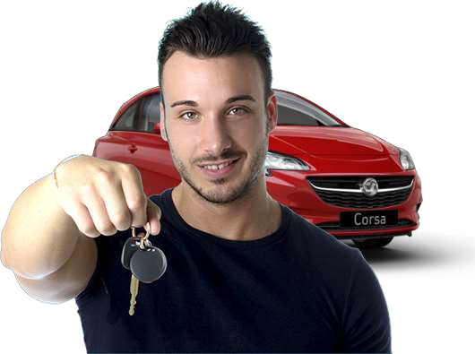
Future Indefinate
Active voice
Affirmative Sentence
He will buy a car.
Negative Sencent
He will not buy a car.
Interrogative Sentence
Will he buy a car.?
Passive voice
Affirmative Sentence
A car will be Bought by him.
Negative Sencent
A car will notbe Bought by him.
Interrogative Sentence
Will a car be Bought by him.?

